Slide 1

Movie Recommendation System
Local movie theater goes Digital

Slide 2
Situation
Wants to embrace the future and go digital with a website
Seek help in the beginning of this journey
To create a movie recommendation engine
Notes:
As a highly skilled team, we accepted this invitation to create/design a dashboard to Help the CEO to easy access to a Dashboard with information about 4 main topics SALES, Finance, Logistcs and HR on a DAILY Basis.

Slide 3

The Solution
Movie Recommendation System
Skills Involved
Colab
Python
Matplotlib
Machine Learning
Streamlit
EASY
FAST
FRIENDLY USER
Notes:
As we all know and because for every Situation/Problem there is a Solution, we are to bring you our project as a easy “Click ’n Go” solution. With this project we want to make the life easier to the director by give access to the information requested, Whenever want or need. This project was created with the tools SQL, Pyton and Colab.

Slide 4

The Tarantinos
Notes:
Off course this project wasn’t possible without the technology of working in remote and this amazing team that could replace the Fantastic 4 from Marvel.

Slide 5



And now please, sit back, relax and enjoy the presentation...
The Tarantinos
Alex, Carlos, Zé, Susu
Data Analysis
Finale
Single-Take
19/11/2021
Notes:
And now let’s go to the most important...THE REPORT.

Slide 6
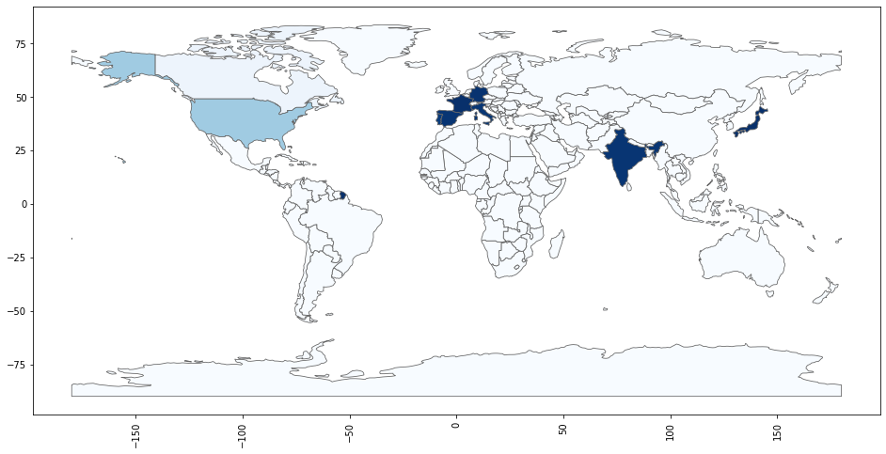
Countries with most productions

Slide 7
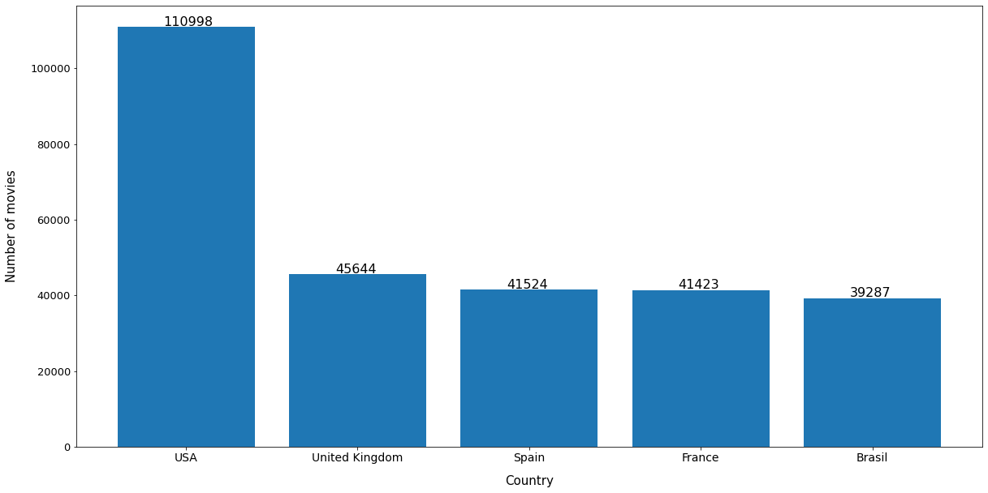
Countries with most productions(only movies)

Slide 8
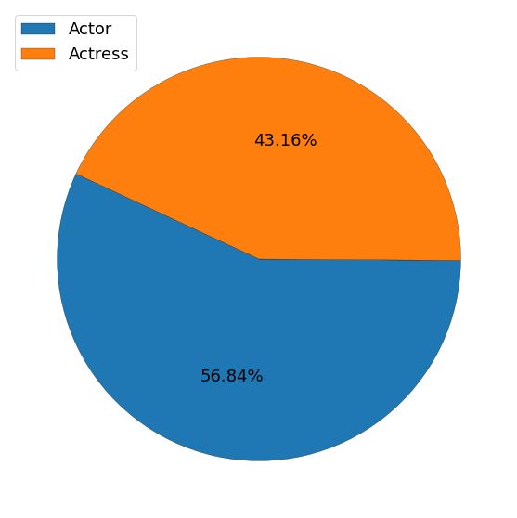

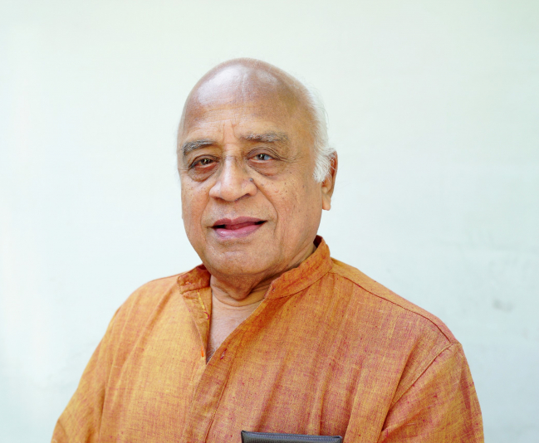
Actor vs Actress
Sameera Sherief
33 years old
(10126)
Delhi Kumar
84 years old
(7834)

Slide 9
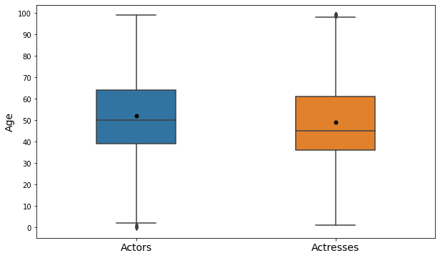
Actors and Actresses ages

Slide 10
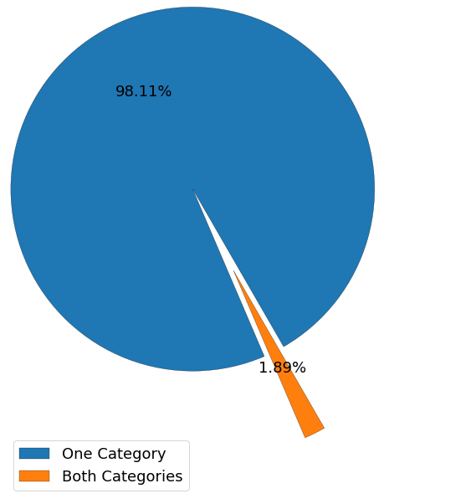
Presence of Actors/Actresses on Movies/TvSeries
Name:
Michael Fairman (USA, 87) - Actor
Craig Stevens (USA, 81) - Actor
Amar Upadhyay (India, 45) - Actor
Keneilwe Matidze (South Africa, 39) - Actress
Rabia Soyturk (Turkey, 25) - Actress

Slide 11
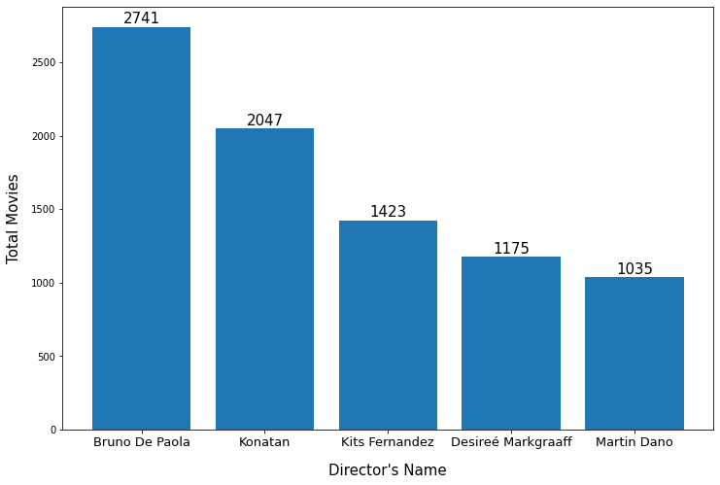
Directors by Movies

Slide 12
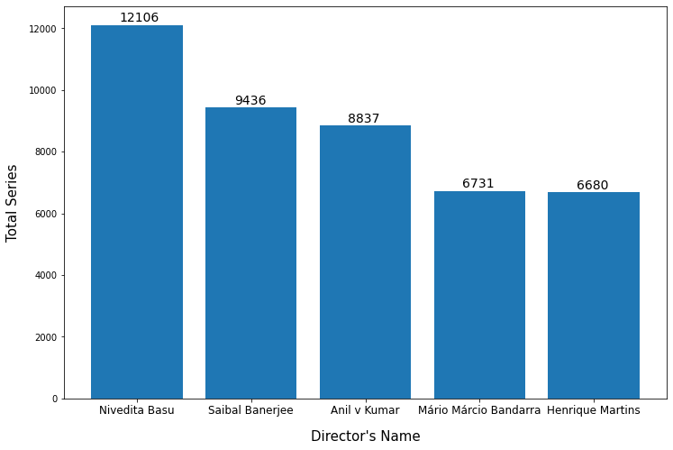
Directors by Series

Slide 13






Top rated movies
#1 - Cabin
#2 - Tari Sathe
#3 - The Inglorious Pacifist
#4 - The Great Escape
#5 - The cult of Bette Davis
10
10
10
10
10
561
432
402
264
220

Slide 14





Most voted movies with highest rating
#1 - The Shawshank Redemption
#2 - The Godfather
#3 - The Dark Knight
#4 - The Godfather - Part II
#5 - 12 Angry men
9.3
9.2
9.0
9.0
9.0
2486414
1716433
2440141
1192128
735574

Slide 15





Top rated shows
#1-Generations
#2- Growing Up Creepie
#3 Little Mom
#4 The George Lucas Talk Show
#5 Secrets of America's
10
10
10
10
10
5248
4690
3448
1373
1034

Slide 16





Most voted movies with highest rating
#1 - Attack on Titan
#2 - Dark
#3 - Breaking Bad
#4 - Mr.Robot
#5 - Person of Interest
9.3
9.1
9.0
9.0
9.0
1115515
310596
1545001
363999
336063

Slide 17


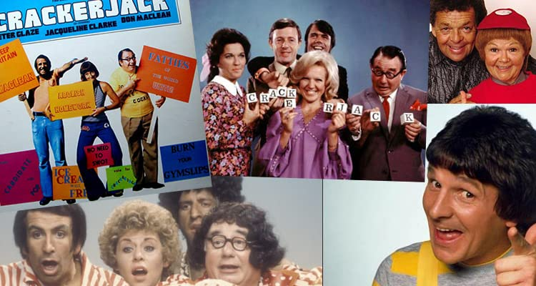




Shows with the most years on air
#1 - Allen and Kendal
#2 - Der internationale Frühschoppen
#3 Crackerjack!
#4 - The Red Skelton Hour
#5 - British Pathé News
1955 - 2021
1951 - 2016
1910 - 1970
1940 - 2015
1953 - 2021
66y
65y
60y
75y
68y

Slide 18
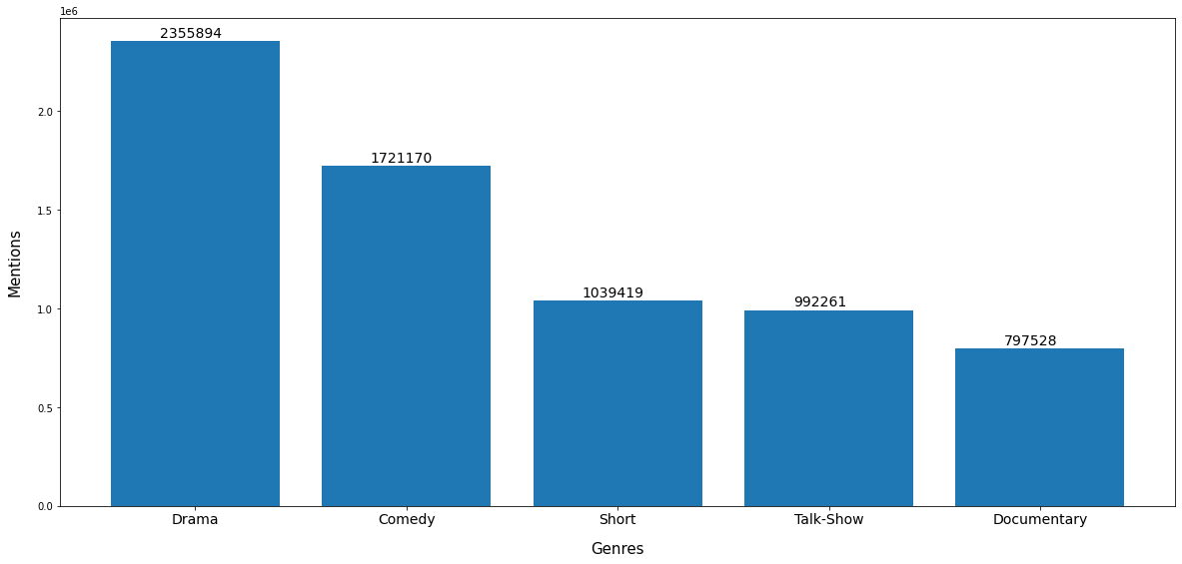
Most genres in productions

Slide 19
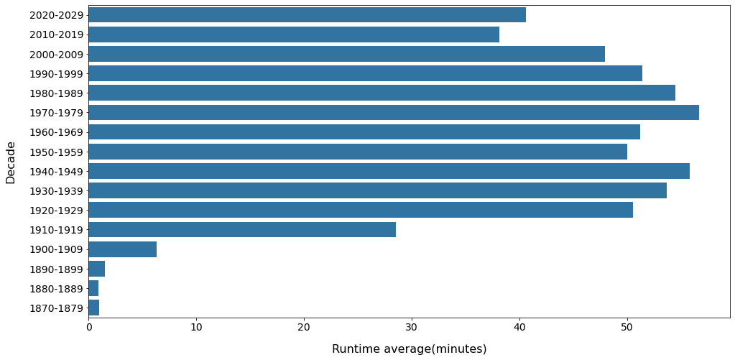
Average length of movies over the years

Slide 20

Movie Recommendation System
Machine Learning
230.000 movies
1893-2020
English language mainly
Predictions based on:
Genre
Director
Average Rating
Year

Slide 21


Slide 22

Any Questions?

